Slide 1


Emergency Response System: A C++ Solution
This presentation explores the design and development of a C++-based emergency response system, addressing the challenges of rapid response and efficient resource allocation.
By:
Muhammad Akram Khan – 2023370
Muhammad Sufyan - 2023523

Slide 2
What is the Emergency Response System?
Purpose
Key Features:
The Emergency Response System is a software designed to manage and prioritize emergencies based on severity and location. It also calculates the shortest path between various locations to facilitate efficient dispatching of emergency responders.
Manage Emergencies: Add, delete, and view emergencies.
Prioritize Emergencies: Sort emergencies based on severity.
Route Optimization: Use Dijkstra's algorithm to find the shortest path between locations.

Slide 3

Why This System?
Real Time Emergency Management
In critical situations, it is important to quickly assess and prioritize emergencies. This system allows for efficient management of emergency situations.
Improved Response Time
By calculating the shortest path between locations, the system ensures that emergency responders take the quickest route to the scene.
Efficient Resource Allocation
Sorting emergencies by severity helps allocate resources to the most critical situations first.

Slide 4



System Architecture and Design
1
Emergency Management (Linked List)
Stores emergency details like location, severity, and status.
2
Graph Representation (Adjacency Matrix)
Locations as nodes, distances between them as edges.
3
Dijkstra's Algorithm (Shortest Path Calculation)
Calculates the shortest path from the central station (Topi Bazaar) to other locations.
4
Emergency Sorting (QuickSort)
Sorts emergencies by severity to prioritize critical cases.

Slide 5
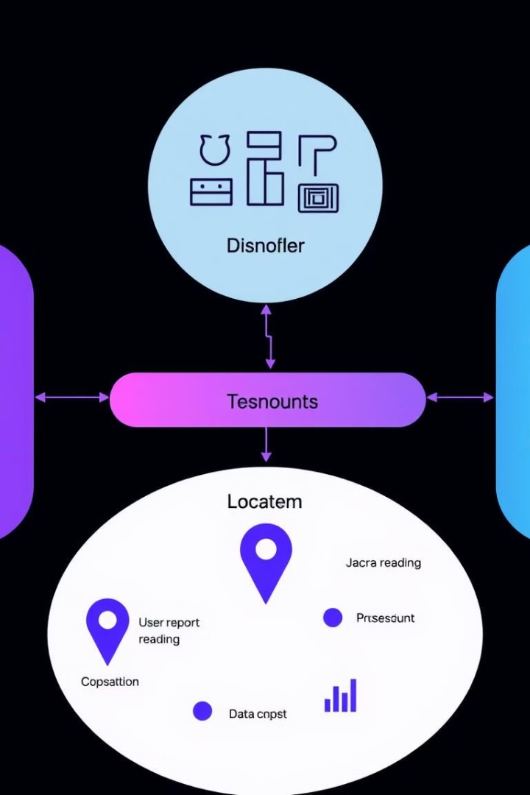
Code Breakdown: Emergency Management
1
addEmergency
Adds new emergencies which includes their Status, Location and Severity
2
deleteEmergency
Deletes emergencies by location.
3
printEmergencies
Displays all emergencies

Slide 6

Code Breakdown: Graph Representation
Adjacency Matrix
The locations are represented as a 2D array where the rows and columns represent the locations, and the values represent the distance between them
Functions
initializeGraph: Initializes the adjacency matrix with infinite distances (no direct connections).
addEdge: Adds a direct connection (edge) between two locations.

Slide 7


Code Breakdown: Shortest
Path Calculation
Dijkstra’s Algorithm
Dijkstra’s algorithm is used to find the shortest path from a central station (Topi Bazaar) to all other locations
Steps:
Initialize the distance array with infinite values.
Set the distance of the source to 0.
Iteratively find the nearest unvisited node and update distances to neighboring nodes.

Slide 8

Code Breakdown: Sorting
Emergencies
QuickSort Algorithm
The QuickSort algorithm is used to sort the emergencies based on their severity, with the highest severity emergencies prioritized.
Steps
Select a pivot (first emergency).
Partition the list into emergencies with higher severity and lower severity
Recursively sort both partitions

Slide 9
Conclusion and Future Enhancements
Future Improvements
Graph Expansion: Add more locations and dynamic edge weights.
Priority Queue: Use a priority queue for more efficient emergency handling.
User Interface: Develop a graphical user interface (GUI) for better user experience.
Conclusion:
The Emergency Response System is a powerful tool for managing emergencies by prioritizing based on severity and optimizing response time using shortest path algorithms and it can be expanded to handle larger datasets, integrate real-time data, and improve user interaction.

